Slide 1
Classification of Dataco supply chain using Machine learning
Name : Manish
Mentor : Mr. Pranab Das
Batch: MBA in Business Analytics April 2022

Slide 2
Index
Introduction
Algorithm and hardware setup
Business Case and Project Goals
Dataset Overview
Data Preprocessing
Data Visualisation
Trend Analysis
Heatmap Analysis
Model Building
Potential Improvements and challenges
References

Slide 3
Introduction
DataCo is a leading company in the field of global supply chain management, specializing in providing innovative solutions for logistics and delivery services.
Overview: The project aims to revolutionize DataCo's global supply chain management by accurately predicting late deliveries through advanced data analytics.
Importance of Supply Chain Optimization: In today's competitive landscape, efficient supply chain management is crucial for meeting customer expectations, reducing costs, and gaining a competitive edge.

Slide 4
Algorithm and Hardware Setup
Machine learning is a branch of computer science which has several ML algorithms which learns from past data and makes predictions.
If we train ML model with both x (input) & y (output) variables, then it is supervised machine learning.
Algorithm Used in project: Classification Algorithm (It is used when target variable is categorical/discrete.)
Hardware Requirements:
A standard laptop/PC with at least 4GB RAM and an Intel i3 or higher/AMD processor, additionally requires a GPU for faster training time and a standard internet connection to download libraries.

Slide 5
Business Case and Project Goals
Challenges in Supply Chain Management: Escalating demand, intricate logistics, and the risk of late deliveries undermine customer trust and profitability.
Goal of the Project: The project aims to leverage machine learning techniques to analyze historical delivery data, predict late deliveries, and strengthen DataCo's delivery competence, customer satisfaction, and strategic decision-making.
Importance of Timely Insights: Timely insights from the project will enable DataCo to proactively address late deliveries, retain customers, increase customer lifetime value, and enhance return on investment.

Slide 6
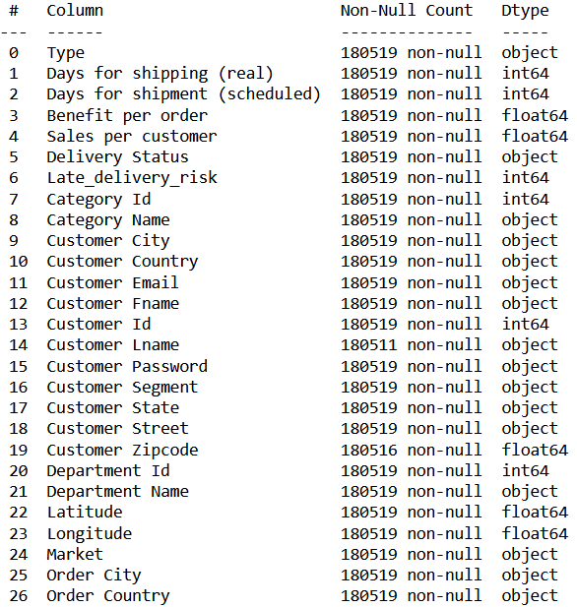
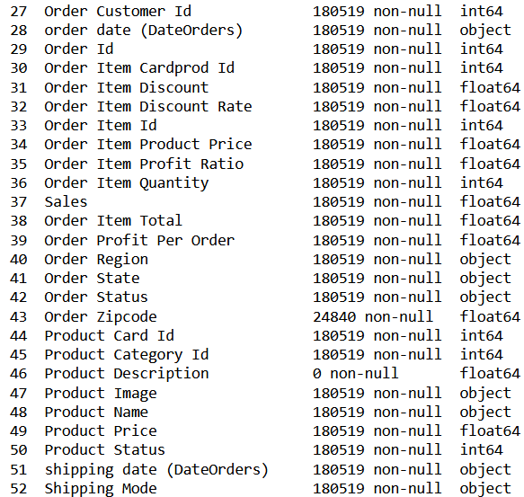
Dataset Overview
Description of the Dataset: The dataset consists of 180,519 rows and 53 columns, encompassing various aspects of the supply chain, including order processing, shipping, delivery.
Types of Data: The dataset includes categorical and numerical attributes, providing a comprehensive view of DataCo's supply chain operations. With 24 categorical attributes and 29 numerical attributes in the dataset.

Slide 7
Data Preprocessing
It is cleaning the Data for Modeling.
In this project:
Handled Null Values in (‘Product Description’, ‘Order Zipcode’,’ Customer Lname’, ‘Customer Zipcode’ column’s).
No duplicated data where found in dataset.
We check for columns with less than 2 unique values as they give no information for our models and delete them - columns ‘Customer Email’, ‘Customer Password’.
Further dropped irrelevant columns : ‘Category Id’, ‘Customer Fname’, ‘Customer Id’, ‘Customer Lname’, ‘Department Id’, ‘Order Customer Id’, ‘Order Id’, ‘Order Item Cardprod Id’, ‘Order Item Id’, ‘Product Card Id’, ‘Product Category Id’, ‘Product Image’, ‘Customer Country’, ‘Customer State’, ‘Customer Street’.
Handled outliers using Winsorize method (bringing the outliers values to be closer to the rest of the data).

Slide 8
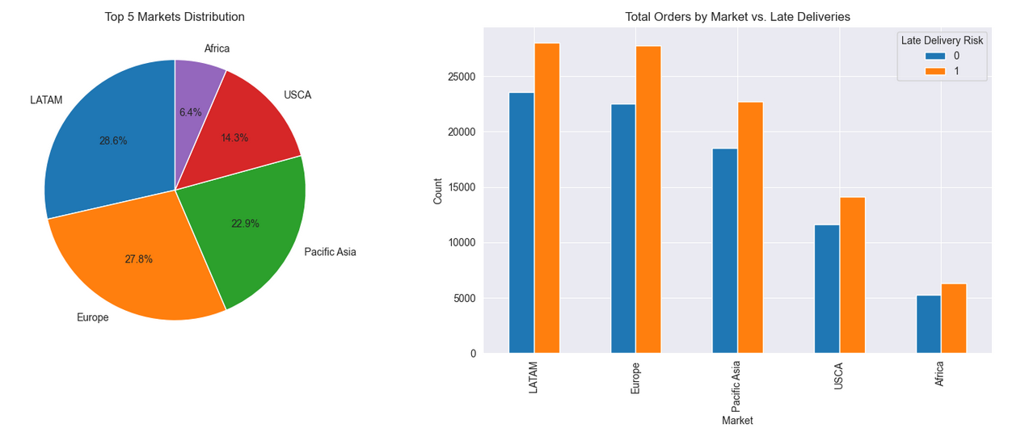
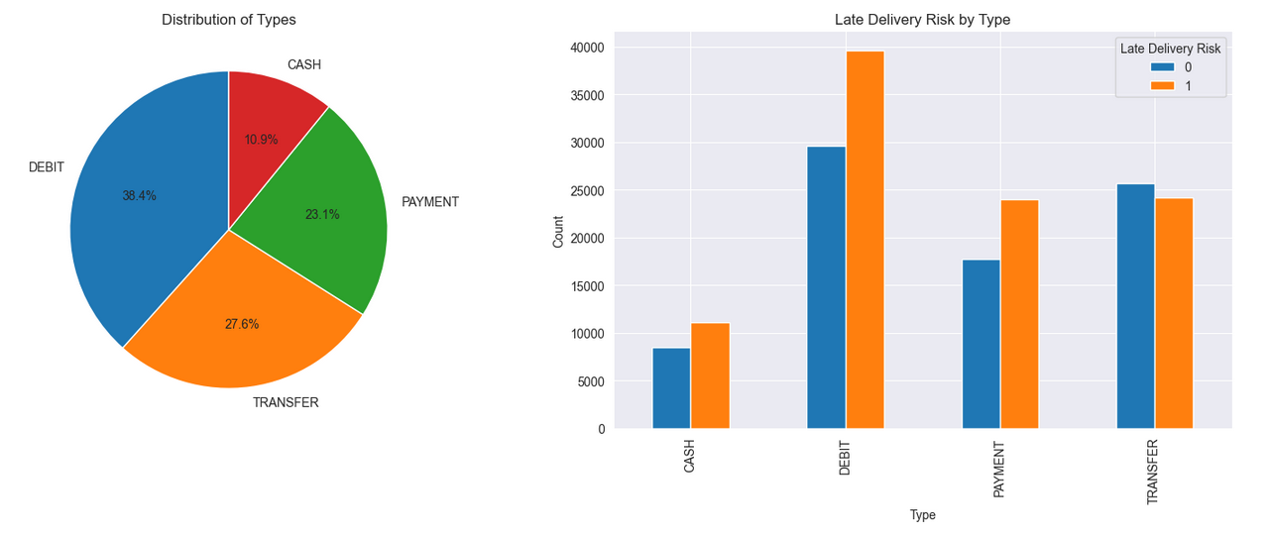
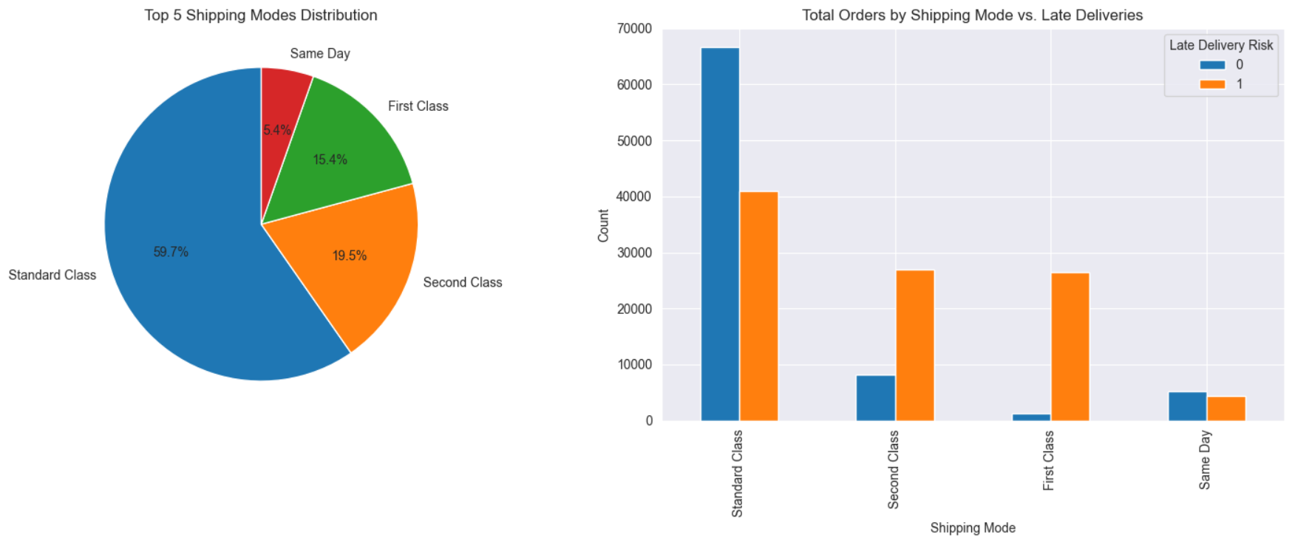
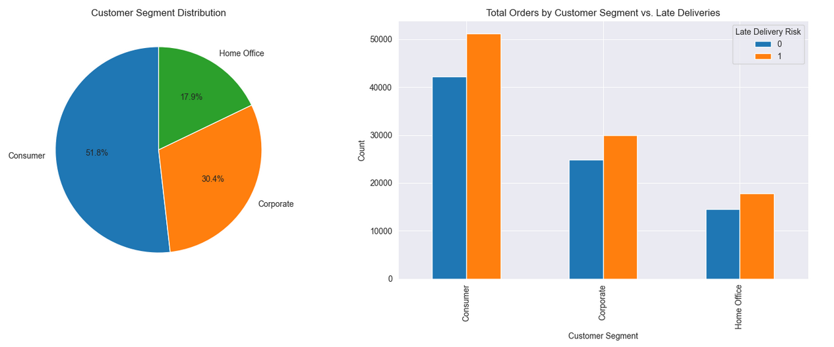
Data Visualization – With aspects of late delivery

Slide 9
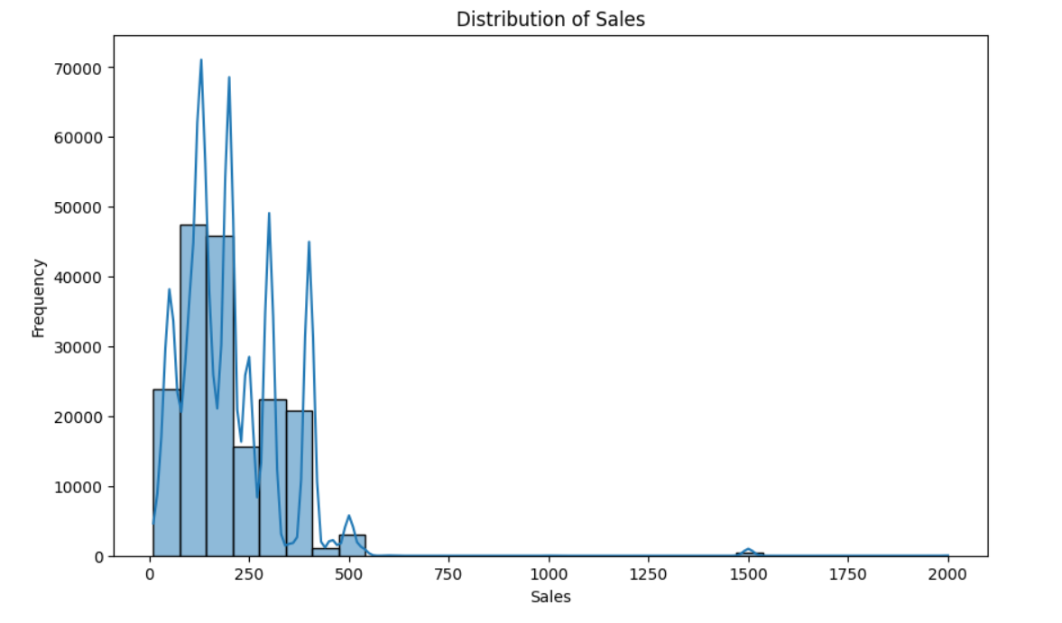
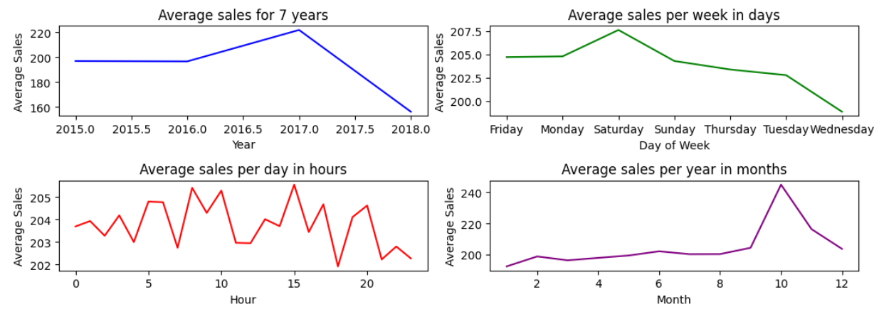
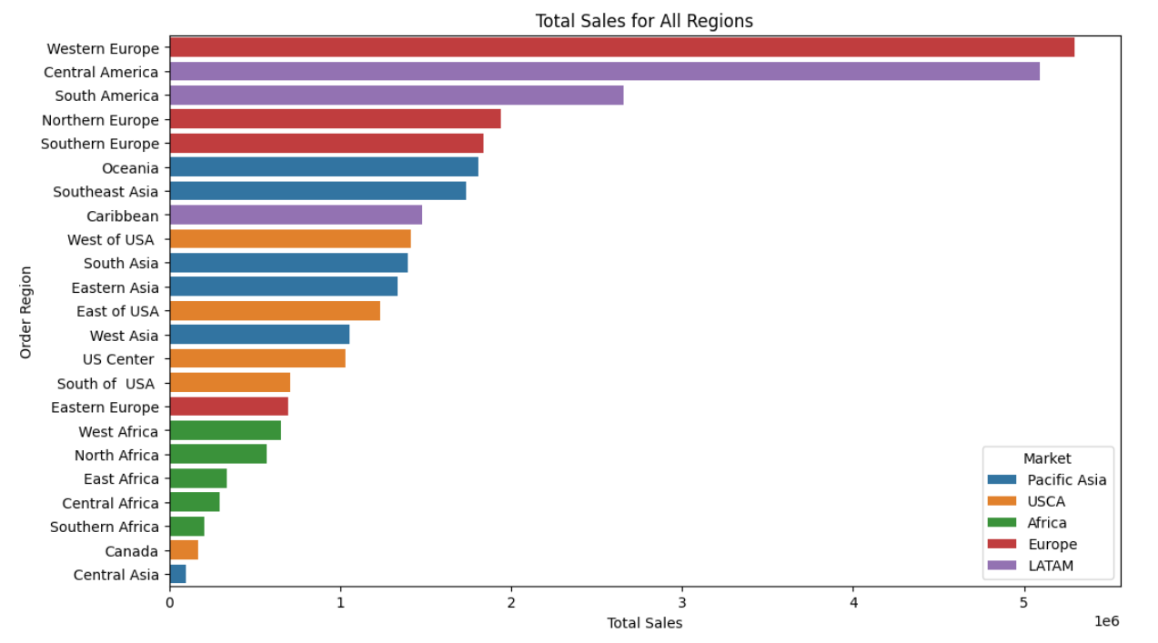
Trends Analysis
Trends in Average Sales.

Slide 10
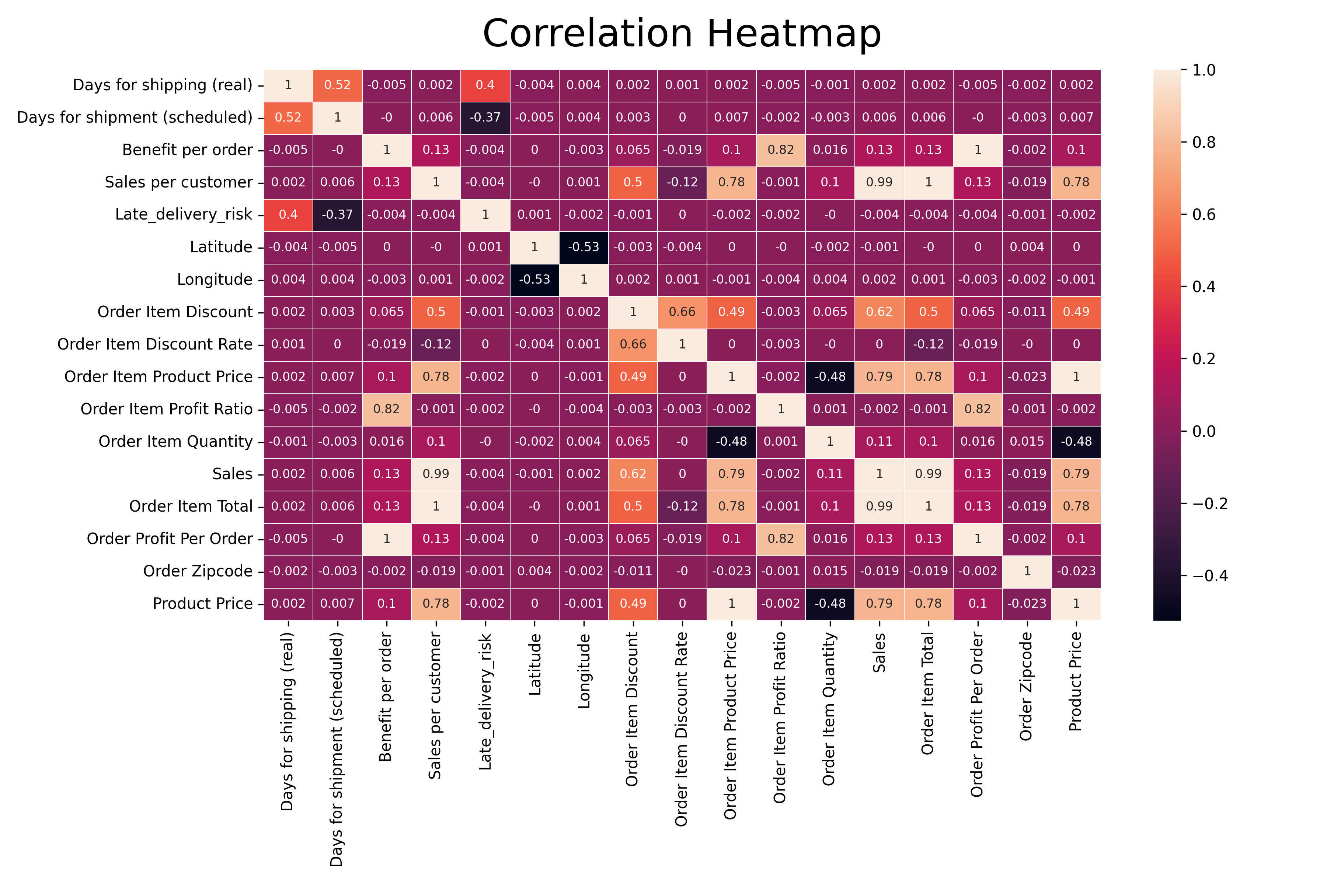
Heatmap: Analysis of Relevant Features
Correlation Analysis:
Understanding the correlation between different attributes in the dataset.
We have deleted ‘Benefit per order’, ‘Sales per customer’, ‘Order Item Product Price’, ‘Sales’ columns from pair having correlation > 0.85 as it gives similar information in the dataset.

Slide 11
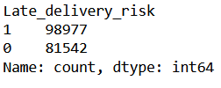
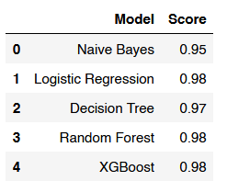

Model Building
Target Variable: Late Delivery Risk
Train-Test Split: Splitting the dataset 75:25 into training and testing sets.
Used Standard Scalar after split to scale only the training dataset to avoid data leak.
Model Used: Logistic Regression, Naïve Bayes, Decision Tree Classifier, Random Forest Classifier and XGBoost.
Model Performance:
Logistic Regression, Random Forest, and XGBoost models are the best performers for numerical attributes.
Logistic Regression is the best performer for categorical attributes.

Slide 12
Potential Improvements and Challenges
Delivery Time Optimization: Implementing predictive analytics models and streamlining logistics operations to minimize delivery delays.
Customer Segmentation and Targeted Strategies: Tailoring delivery services and marketing campaigns based on customer segments.
Supplier Relationship Management: Strengthening partnerships with suppliers to ensure timely product deliveries.
Inventory Management Optimization: Utilizing inventory management systems and demand forecasting techniques.
Technology Integration and Automation: Leveraging advanced technologies for real-time monitoring and decision-making.
Training and Development Programs: Providing training programs to enhance skills and customer service abilities.
Customer Feedback and Communication: Soliciting feedback from customers to improve service quality and address concerns.

Slide 13
References
Dataset link : https://data.mendeley.com/datasets/8gx2fvg2k6/5
Various Projects https://github.com/
Various Projects https://kaggle.com/
How Data Analytics Can Help Improve Your Supply Chain. Available at: https://www.linkedin.com/pulse/how-data-analytics-can-help-improve-your-supply-chain-dfreight/?trk=public_post

